Slide 1
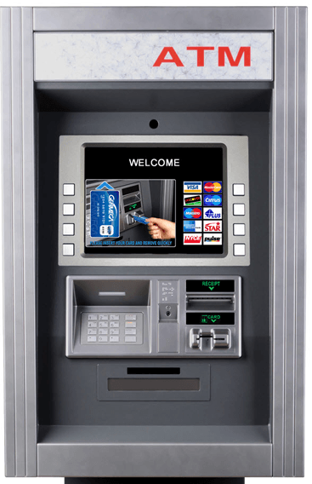
ATM Database system

Slide 2
INTRODUCTION
ATM's full form is Automated Teller Machine which is a self-service banking outlet.
You can withdraw money, check your balance, or even transfer funds.
These machines allow you to undergo self-serviced transactions without the help of an actual teller and without having to visit the bank branch.
Automated teller machines or ATMs allow many transactions, including cash withdrawals, cash deposits, and fund transfers.

Slide 3
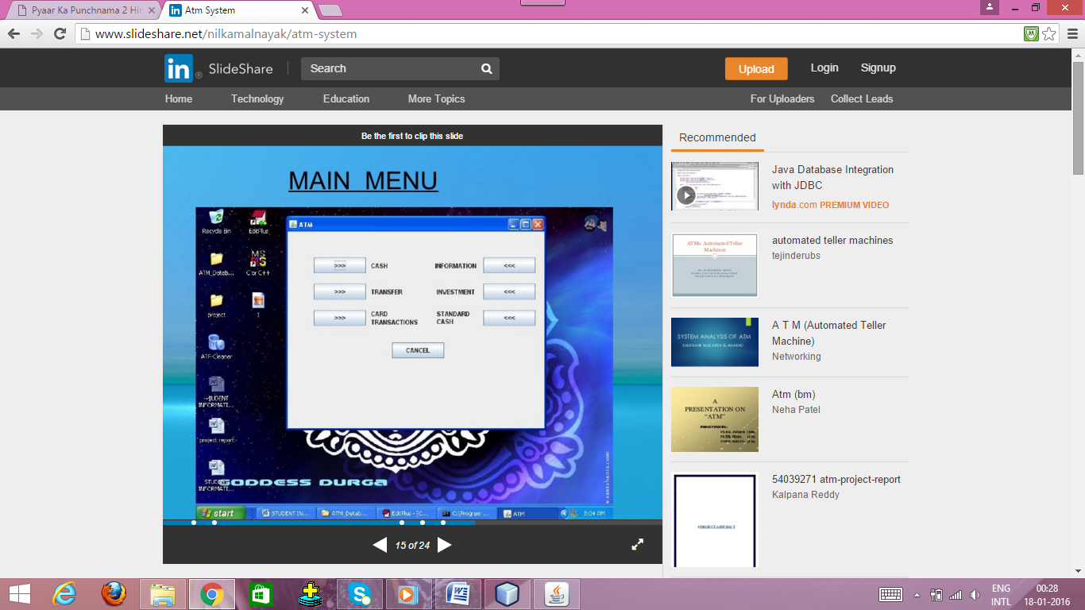
Proposed system
ATM database system provides user the option to access information about their accounts and make cash transactions and even change their passwords online.
User can interact with the bank through this card. Some more facilities are there by using this machine.

Slide 4
SCOPE
Using an ATM, customers can access their bank deposit or credit accounts in order to make a variety of financial transactions, most notably cash withdrawals and balance checking, as well as transferring credit to and from mobile phones.
ATMs can also be used to withdraw cash in a foreign country.
ATM is a way of performing quick and easy transactions on an individual basis.
Its device that enables customers to perform transactions, such as cash withdrawals, deposits, funds transfers, balance inquiries for 24/7 and without the need for direct interaction with bank staff.

Slide 5
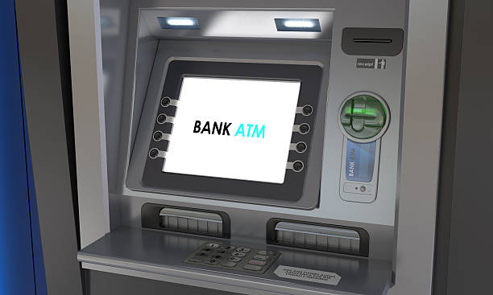
FEAtures
Transfer funds between linked bank accounts
Receive account balance
Prints recent transactions list
Change your pin
Deposit your cash
Prepaid mobile recharge
Bill payments
Cash withdrawal

Slide 6
Existing system
Manually performing transactions and other ATM related actions in the banks is not always possible.
There may be cases of emergencies or public holidays which makes it impossible to gain access to these facilities at every time.
Also it is time taking and exhaustive in case there is a long queue of customers at the bank or even at the ATM kiosk that are generally provided by banks at various places.

Slide 7
modules
Cash module:- shows denominations of money.
Transfer module:- lets users to transfer cash from one account to another. The inputs are password of sender and receiver and amount of money to be transferred.
Card transactions module:- has two sub-modules:
Change password:- allows the user to change his current password.
Dept paying:- designed to pay debts or loans like credit debts, education debts, insurance debts, etc.
Standard Cash Module:- lets user see details of his account like name, password and the amount left after the standard deduction of a fixed amount.
Information Module:- lets the user see the remainder amount in his account after a transaction.

Slide 8
SECURITY FEATURES
ATMs are targets for fraud, robberies and other security breaches.
ATMs are becoming more complicated and they now serve numerous functions, thus becoming a high priority target for robbers and hackers.
Modern ATMs are implemented with high-security protection measures.
On-Line PIN validation.
Off-Line PIN validation.
PIN validation for interchange transactions.
Hardware security module.
Authentication and data integrity.

Slide 9
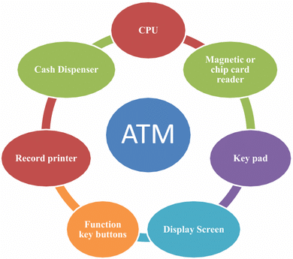
HARDWARE COMPONENTS

Slide 10
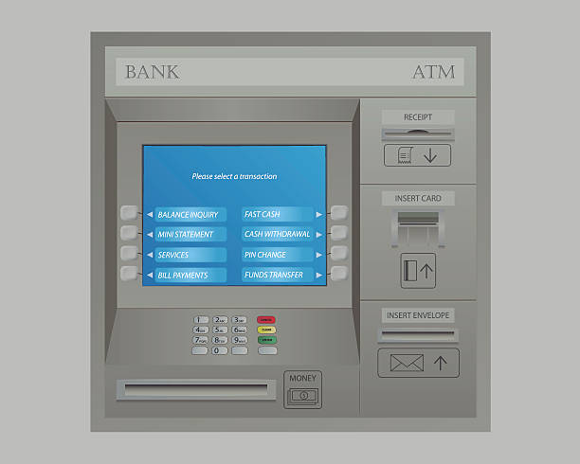
Requirements
Software Requirements
JVM
Hardware Requirements
Hard Disk – 2 GB.
RAM required – 1 GB (minimum)
Technology Used
Java
MS Access

Slide 11
Thank you…!

